Slide 1
第9章: Dimension Reduction
Principle component analysis (PCA)
Singular value decomposition (SVD)
Regularized SVD
Nonnegative matrix factorization (NMF)
Multidimensional scaling (MDS)

Slide 2
Curse of Dimensionality.
A major problem is the curse of dimensionality.
If the data x lies in high dimensional space, then an enormous amount of data is required to learn distributions or decision rules.
Example: 50 dimensions. Each dimension has 20 levels. This gives a total of cells. But the no. of data samples will be far less. There will not be enough data samples to learn.

Slide 3
Curse of Dimensionality
One way to deal with dimensionality is to assume that we know the form of the probability distribution.
For example, a Gaussian model in N dimensions has N + N(N-1)/2 parameters to estimate.
Requires data to learn reliably. This may be practical.

Slide 4
Dimension Reduction
One way to avoid the curse of dimensionality is by projecting the data onto a lower-dimensional space.
Techniques for dimension reduction:
Principal Component Analysis (PCA)
Singular value decomposition (SVD)
Nonnegative matrix factorization (NMF)
Multi-dimensional Scaling (MDS).

Slide 5
Part I Principle Component Analysis (PCA)

Slide 6
Dimension Reduction & PCA
PCA used to reduce dimensions of data without much loss of information.
Used in machine learning and in signal processing and image compression (among other things).

Slide 7
Variance and Covariance
Let X, Y are random variable

Slide 8
Multivariate Random Variable
For multidimensional random vector

Slide 9
Variance and Covariance
Variance of the multivariate variable (commonly referred to as covariance)
For simplicity, we simply note as

Slide 10
Projection to 1D
Let be the projection, which is a random variable (1D)

Slide 11
Sample Variance and Covariance
Given the i.i.d samples, X⁽¹⁾, X⁽²⁾, ……, X^{(n)}

Slide 12
Principle Components
The first principle component is the projections that catches the maximum variance, we can obtain a optimization problem
The solution is the eigenvector corresponding to the largest eigenvalue

Slide 13
Principle Components
Similarly, we can get the second, third principle components with extra orthogonal constraints,

Slide 14
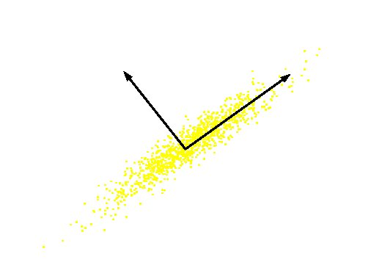
Principal Component
Original Variable B
Original Variable A

Slide 15
Matrix Diagonalization
For a covariance matrix , there exist a orthogonal matrix Q, such that
where

Slide 16
Using Eigenvectors for Diagonalization
Let be a set of orthogonal unit eigenvectors with eigenvalue

Slide 18
Principle Components
Given p orthogonal unit eigenvectors
Let , i.e , where

Slide 19
补充：实对称矩阵理论

Slide 20
正交矩阵
如果我们考察两组标准正交基之间的过渡矩阵Q，由于在标准正交基的内积的度量矩阵是单位阵，那么
我们称满足 Q^{T}Q=E的矩阵Q为正交矩阵；
几何意义：平面上绕坐标原点旋转角度 θ是的变换矩阵是正交矩阵，

Slide 21
实对称矩阵标准化
定理：对应任何一个n阶实对称矩阵A，存在一个n阶的正交矩阵 Q 使得A对角化，

Slide 22
定理证明思路
引理1：实对称矩阵的特征值必是实数。
引理2：不同特征值所对应的特征向量必正交。
引理3：设λ是一个特征值，ε是对于的特征向量，令 ，则M是A的不变子空间且维数为n-1.
证明方法：对维数进行数学归纳法。

Slide 23
实对称矩阵对角化方法
求解方程 , 解出全部特征值；
对每个特征值 λ_{i} , 求出该特征值对应的特征子空间的一种基，即求出下面方程的基础解系
对此组基进行Schmidt正交化；
将所有特征值对应的正交化基以列向量排在一起就得到了正交矩阵。

Slide 24
对称化例子
λ=10时，特征向量v₁=(1,2,-2)^{T}.
λ=1时，特征向量v₂=(0,1,1)^{T},v₃=(2, 0, 1)^{T}
对v₂,v₃ Schmidt正交化

Slide 25
对称化例子
标准化得

Slide 26
Property of Principle Components

Slide 27
Dimension Reduction
Using first k components to reduce the dimension,

Slide 28
How Many Components to Be Selected?
Contribution rate (贡献率), which measure the ability that Z₁,…,Z_{k} can explain X.
Generally one can select k components such that

Slide 29
Property of Principle Components

Slide 30
PCA in R
prcomp(stats)
Principal Components Analysis (preferred)
princomp(stats)
Principal Components Analysis
screeplot(stats)
Screeplot of PCA Results
summary(obj)
loadings(obj)

Slide 31
Part II Singular Value Decompostion (SVD)

Slide 32
奇异值分解(SVD)及其应用
奇异值分解(SVD, Singular Value Decomposition)
Application I: Information retrieval
Application II: Gene expression data analysis
Regularized SVD

Slide 33
奇异值分解(SVD)
定理1：设A是秩为r的实值矩阵，则存在m阶正交矩阵U，n阶正交矩阵V，使得 A=UDV^{T}. 其中D为对角矩阵 满足
则

Slide 34
奇异值分解(SVD)
称 为矩阵A的奇异值。
称U,V的列向量分别称为A的左、右奇异向量。

Slide 35
奇异值分解(SVD)
A^{T}A_{n,n}和AA^{T}_{m,m}都是实对称矩阵，则存在n阶正交矩阵V和m阶正交矩阵U，使得
(A^{T}A)和(AA^{T})的特征值相同
A^{T}A的非0 特征值的个数等于A的秩 r .

Slide 36
Rank, Range, and Null space
The rank of matrix A can be calculated from SVD by the number of nonzero singular values.
The range of matrix A is the left singular vectors of U corresponding to the non-zero singular values.
The null space of matrix A is the right singular vectors of V corresponding to the zeroed singular values.

Slide 37
Rank, Range, and Null space
Null Space
Range
Rank
Rank(A)=3

Slide 38
Condition Number
SVD can tell How close a square matrix A is to be singular.
The ratio of the largest singular value to the smallest singular value can tell us how close a matrix is to be singular:
A is singular if c is infinite.
A is ill-conditioned if c is too large (machine dependent).

Slide 39
奇异值分解(SVD)
定理2 (Eckart and Young )：Let the SVD of A be given by A=UDV^{T} with r = rank(A) < p = min(m, n) and define
Then
其中 为Frobenius 范数, 定义为

Slide 40
奇异值分解(SVD)
In other words, A_{k}, which is constructed from the k-largest singular triplets of A, is the closest rank-k matrix to A. In fact, A_{k} is the best approximation to A for any unitarily invariant norm[*].
* L. MIRSKY, Symmetric gage functions and unitarilly invariant norms, Q. J. Math, 11(1960), pp. 50-59.

Slide 41
矩阵近似
前k个奇异值的贡献率
可以根据贡献率截取前k个奇异值近似矩阵

Slide 42
SVD举例

Slide 43
SVD举例

Slide 44
SVD in R
svd()
la.svd()
A good demo
http://www.ats.ucla.edu/stat/r/pages/svd_demos.htm

Slide 45
SVD vs PCA
If X is centering each column, then X^{T}X is proportional to the covariance matrix of variables g_{i}. So, the right singular vectors {v_{k}} are the same as the principal components.
If instead each row of X is centered, XX^{T} is proportional to the covariance matrix of the variables a_{j}. In this case, the left singular vectors {u_{k}} are the same as the principal components of {a_{j}}.

Slide 46
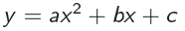
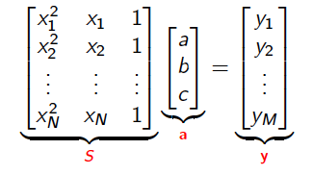
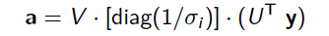
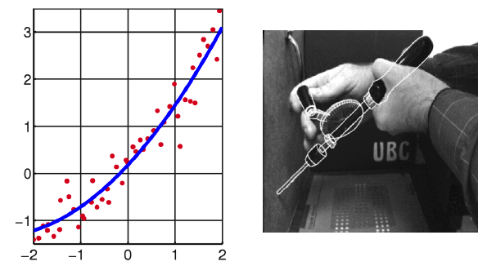
Data Fitting Problem

Slide 47
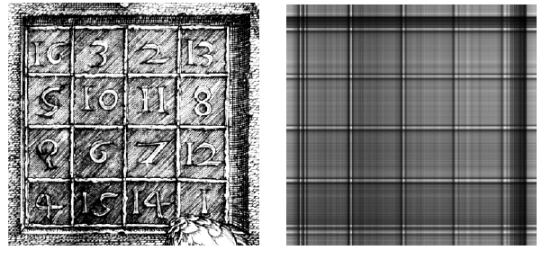
Image Processing
[U,W,V]=svd(A)
NewImg=U(:,1)*W(1,1)*V(:,1)’

Slide 48
Digital Signal Processing (DSP)
SVD is used as a method for noise reduction.
Let a matrix A represent the noisy signal:
compute the SVD,
and then discard small singular values of A.
It can be shown that the small singular values mainly represent the noise, and thus the rank-k matrix A_{k} represents a filtered signal with less noise.

Slide 49
Applications
Information retrieval
LSI: Latent semantic indexing
SVD applied to term document matrix
compute best rank k approximation
eigenvectors correspond to linguistic concepts
Gene expression data analysis
SVD useful preprocessing step
grouping genes by transcriptional response, grouping assays by expression profile

Slide 50
Latent Semantic Indexing (LSI) by Singular Value Decomposition
Michael W. Berry, Susan T. Dumais, Gavin W. O'Brien. Using Linear Algebra for Intelligent Information Retrieval. SIAM Review 37(4): 573-595, 1995.

Slide 51
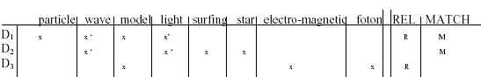
Information Retrieval
Q : “Light waves.”
D₁: “Particle and wave models of light.”
D₂: “Surfing on the waves under star lights.”
D₃: “Electro-magnetic models for fotons.”

Slide 52
Motivation for LSI
To find and fit a useful model of the relationships between terms and documents.
To find out what terms "really" are implied by a query .
LSI allow the user to search for concepts rather than specific words.
LSI can retrieve documents related to a user's query even when the query and the documents do not share any common terms.
Notes:
LSI MOTIVATION:
The goal in LSI is to find and fit a useful model of the relationships
between terms and documents. We want to use the matrix of observed
occurrences of terms in documents to estimate parameters of that model.
With resulting model we can then estimate what the observed occurrences
really should have been. In this way, for instance, we may be able
to predict that a given term should have been associated with a document,
even though, because of variability in word use, no such association was
observed explicitly.

Slide 53
How LSI Works?
Uses multidimensional vector space to place all documents and terms.
Each dimension in that space corresponds to a concept existing in the collection.
Thus underlying topics of the document is encoded in a vector.
Common related terms in a document and query will pull document and query vector close to each other.

Slide 54
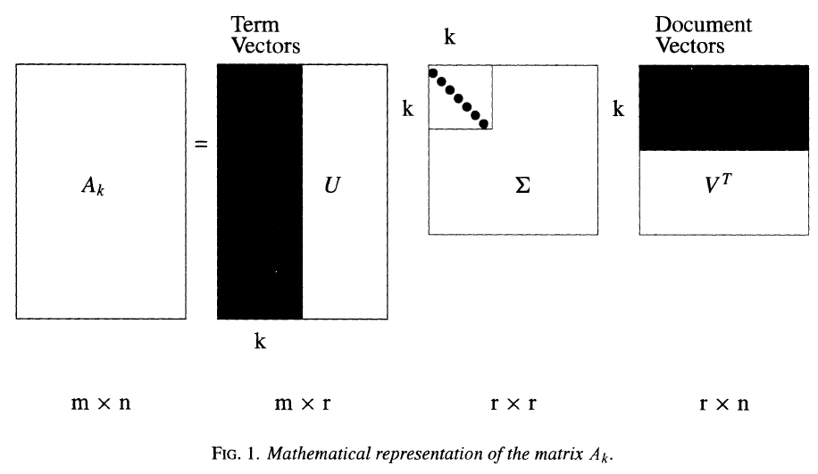
LSI Method
Create a rank-k approximation to A
k < r_{A} or k = r_{A} ,
A_{k} = U_{k} S_{k} V^{T}_{k}

Slide 55
LSI Method
Using truncated SVD, underlying latent structure is represented in reduced-k dimensional space.
Noise in word usage is eliminated

Slide 56
LSI-Procedure
Obtain term-document matrix.
Compute the SVD.
Truncate-SVD into reduced-k LSI space.
k-dimensional semantic structure
Similarity on reduced-space
Term-term
Term-document
Document-document

Slide 57
Query processing
Map the query to reduced k-space
q’=q^{T}U_{k}S⁻¹_{k}
Retrieve documents or terms within a proximity.
Cosine
Best m

Slide 58
Updating
Folding-in
d’=d^{T}U_{k}S⁻¹_{k}
similar to query projection
SVD re-computation

Slide 59
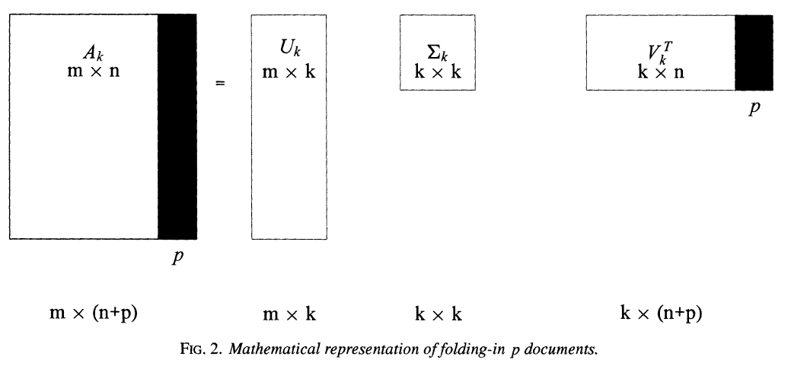
Folding-In (Documents)

Slide 60
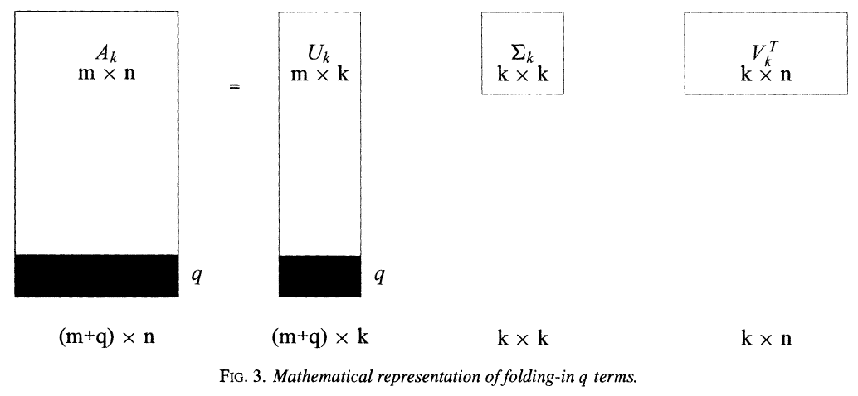
Folding-In (Terms)

Slide 61
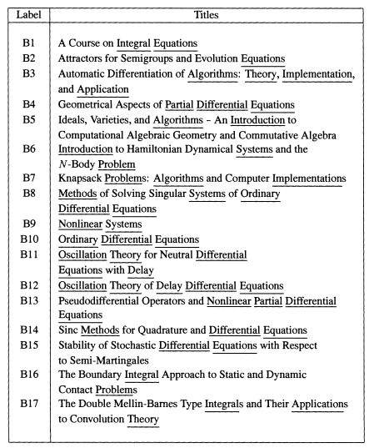
Example:SIAM Review Titles

Slide 62
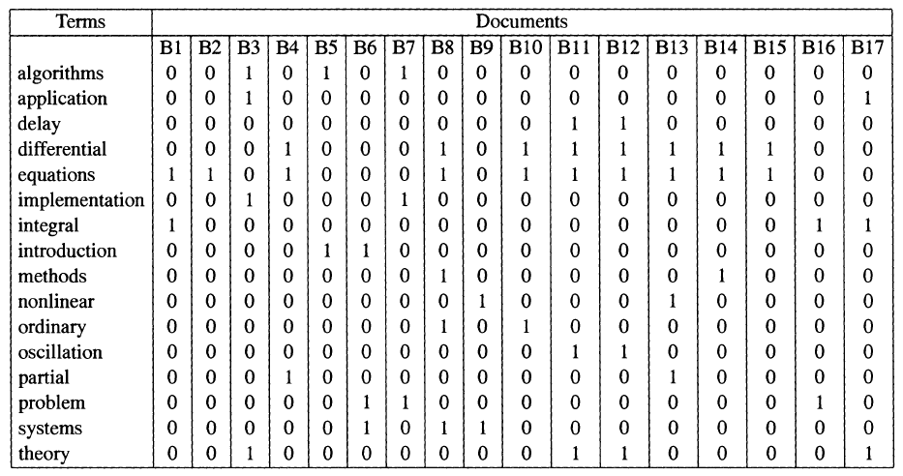
Example

Slide 63
Mapping Method
Compute the truncated SVD (k=2)
Terms plane
x-coordinates : The first column of U₂ multiplied by the first singular value, for the
y-corrdinates: second column of U₂ multiplied by the second singular value.
Documents plane:
x-coordinates : The first column of V₂ scaled by the first singular value, for the
y-corrdinates: second column of V₂ scaled by the second singular value.

Slide 64
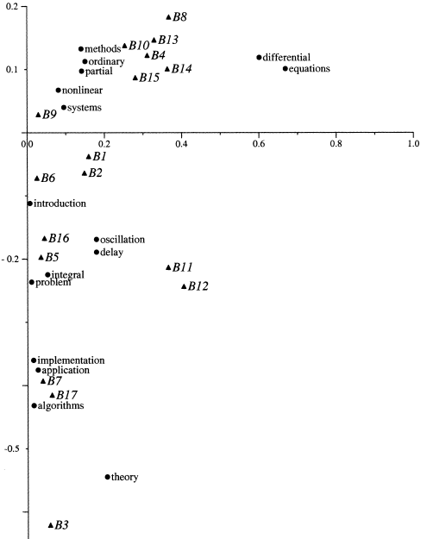
Mapping Results

Slide 65
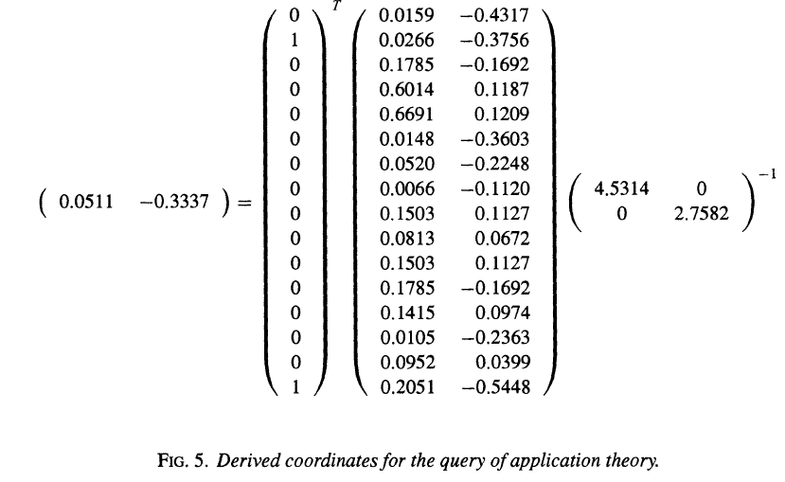
Query
Query: “application and theory”
q^{T} = [ 0 1 0 0 0 0 0 0 0 0 0 0 0 0 0 1 ].

Slide 66
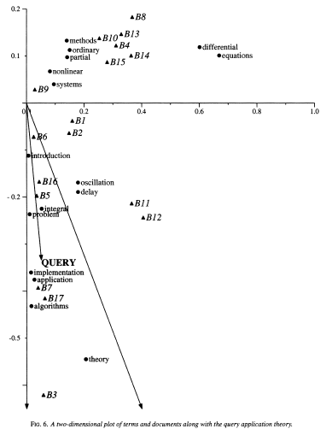

Slide 67
Comparison with Lexical Matching
Query of “Application and theory”; k=2
Using a cosine threshold of 0.9 returns 6 books: B₃, B₅, B₆, B₇, B₁₆, and B₁₇.
Using a cosine threshold 0.55 also returns B₁₁ and B₁₂ (somewhat related)
But lexical matching only returns 4 books: B₃, B₁₁, B₁₂, B₁₇

Slide 68
Gene Expression Data Analysis Using SVD
Wall, Michael E., Andreas Rechtsteiner, Luis M. Rocha."Singular value decomposition and principal component analysis". in A Practical Approach to Microarray Data Analysis. D.P. Berrar, W. Dubitzky, M. Granzow, eds. pp. 91-109, Kluwer: Norwell, MA (2003). LANL LA-UR-02-4001.

Slide 69
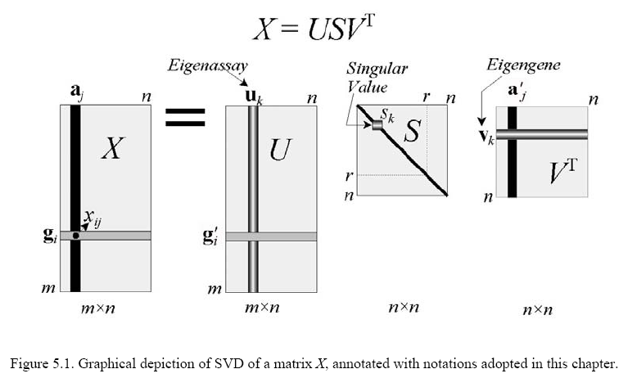

Slide 70
Left Singular Vector and Right Singular Vector
The right singular vector span the space of the gene transcriptional responses {g_{i}};
The left singular vectors span the space of the assay expression profiles {a_{j}}

Slide 71
Eigen-vectors
Genes: linear combination of eigen-genes {v_{k}}
Assays: linear combination of eigen-assays {u_{k}}

Slide 72
Dimension Reduction
Using the idea of truncated-SVD, we can represent expression profiles as,
where d<r=rank(X).
In another word, we treat the last several singular values only contributing to the noise.

Slide 73
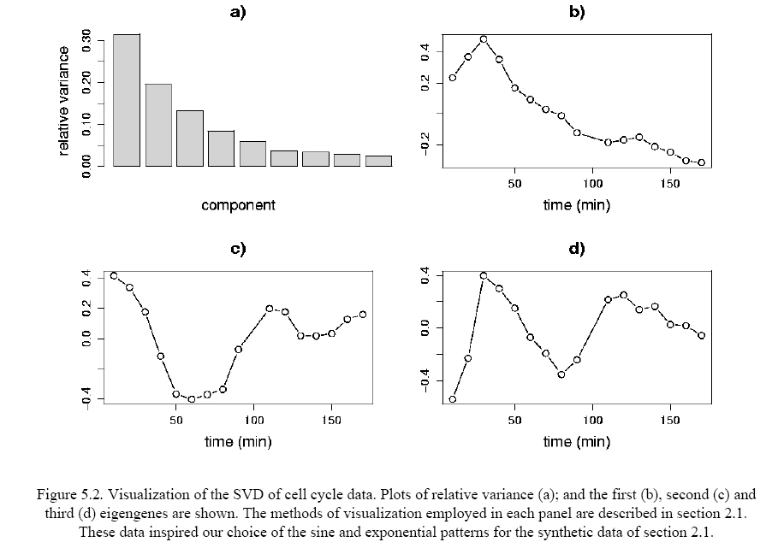

Slide 74
Synthetic Time Series Data
2000 x 14
1600 noisy genes
200 genes with noisy sine patterns
200 genes with exponential patterns

Slide 75
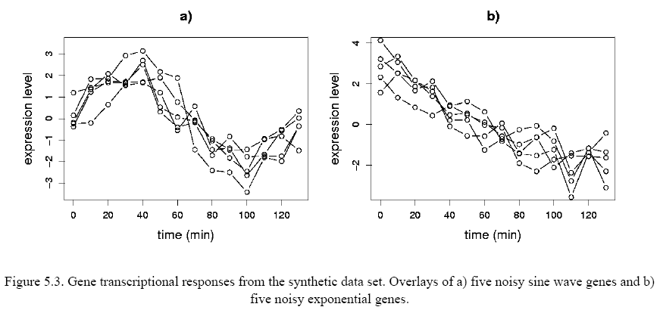
Synthetic Data

Slide 76
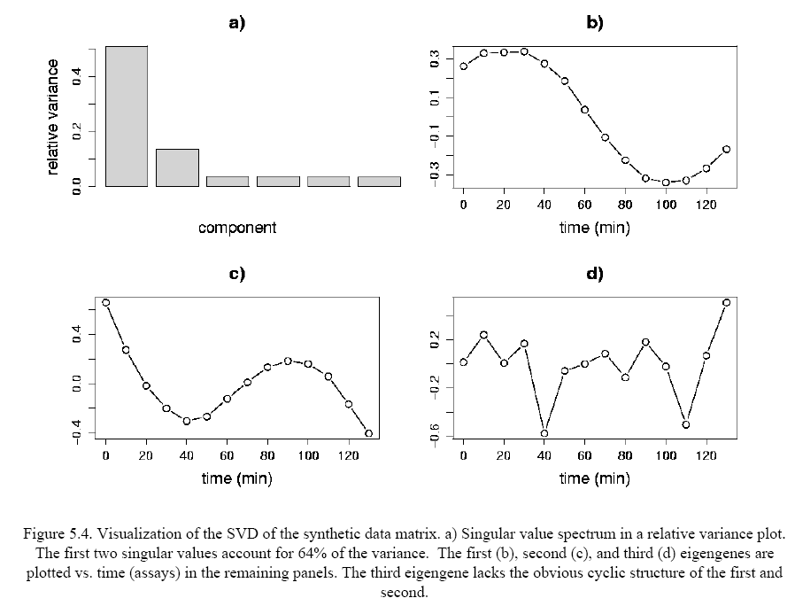

Slide 77
Scatter Plots
Projection of data into SVD subspaces and visualization with scatter plots can reveal structures in the data that may be used for classification.
Two gene “coordinates” for scatter plots
Projection
Correlation

Slide 78
Scatter Plots
Projection of g_{i} on eigen-gene v_{k}
Correlation between g_{i} and eigen-gene v_{k}

Slide 79
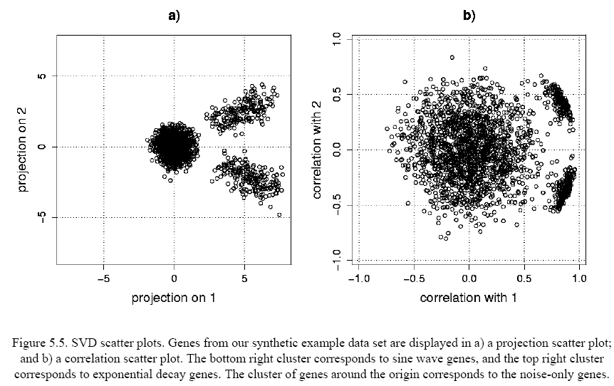

Slide 80
More Applications
Netflix prize, big data, SVD and R
http://blog.revolutionanalytics.com/2011/05/the-neflix-prize-big-data-svd-and-r.html

Slide 81
Regularized SVD

Slide 82
Netflix Prize
Netflix是一家在线电影租赁公司。
从1998年10月到2007年8月，收集了11,700,000个用户，85,000部电影的1,900,000,000个评分(1-5)
2006年10月，Netflix Prize发布：数据集包含随机抽取的480,189个用户，17,770的评分。第一个超过它自己的推荐系统Cinematch 10%的团队获得$1M的Grand prize.
A team "BellKor's Pragmatic Chaos" win the $1M Grand Prize on September 21, 2009.

Slide 83
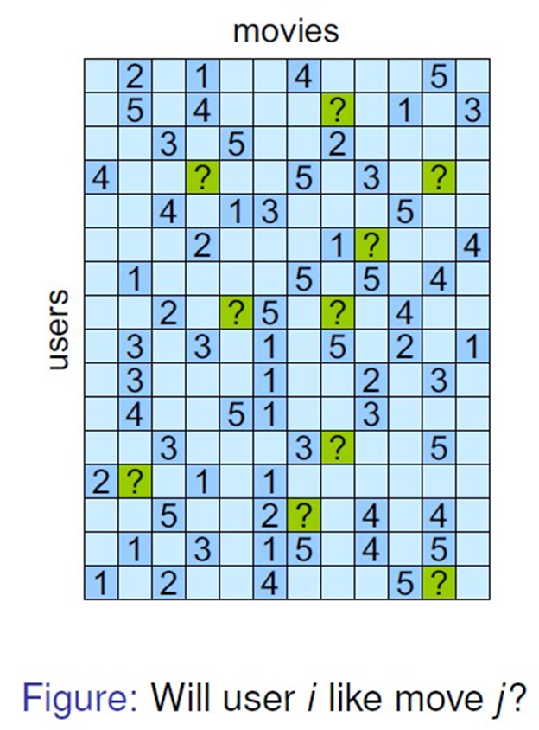
Netflix Prize

Slide 84
Imputation Strategy
Delete missing entries or fill with mean (or median)
Local methods (nearest neighbor-based )
Correlation based methods

Slide 85
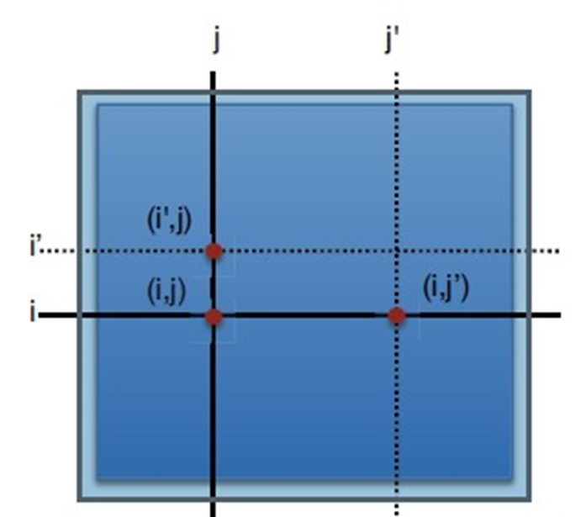
Previous Methods
Local methods
kNN: k-Nearest Neighbors
LLS: Local Least Square
iLLS: Iterated Local Least Square
Correlation based
BPCA:Bayesian Principal Component Analysis
SVD: Singular Value Decomposition

Slide 86
Imputation with Correlation
The basic idea is that the “similar” users’ rating are globally similar.
Extreme case: if all users are belong to same class, the their rating is almost the same, the rank of the matrix is ONE!
So one may expect that the rank of the rating matrix will be close to the number of classes of users.
LOW RANK!

Slide 87
Imputation with Correlation
Mathematical formulation

Slide 88
SVD Imputation
Z: the best rank-J matrix approximation to X
Impute missing X_{ij} with Z_{ij}
But the rank(Z) constraint makes the problem non-convex

Slide 89
Soft-SVD Imputation
-- sum of singular values of Z--is convex in Z, which is called as “nuclear norm” of Z.
tightest convex relaxation of rank (Z)
X: data matrix
denotes the observed data
Z: the approximation of X

Slide 90
Solve the Optimization Problem
This optimization problem can be reformulated to Lagrange form:
Define an orthogonal projection operator P:
is a regularization parameter
Notes:
Suppose we only observed a subset of X, indexed by , and the missing entries are indexed by .

Slide 91
Solve the Optimization Problem
The Lagrange form can be written in a nice form:
Theorem. If matrix W_{m,n} has rank r, then the optimization problem,
has solution , where
Mazumder. R, 2010, the Journal of Machine Learning Research

Slide 92
Solve the Optimization Problem
With an arbitrary initialization we start the iteration until convergence
Updating Z
Parameter tunning:
Set rank(Z)=min(m,n)
Add artificial deletions

Slide 93
Part III Nonnegative Matrix Factorization (NMF)

Slide 94
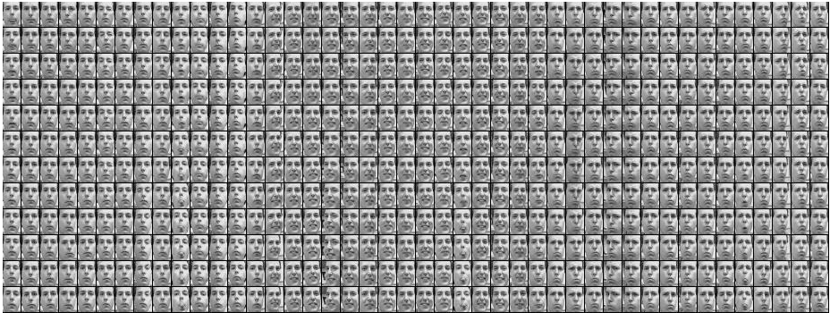
Image Analysis
Put m images (with n pixels) together, we have a nxm matrix.

Slide 95
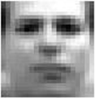
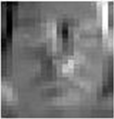
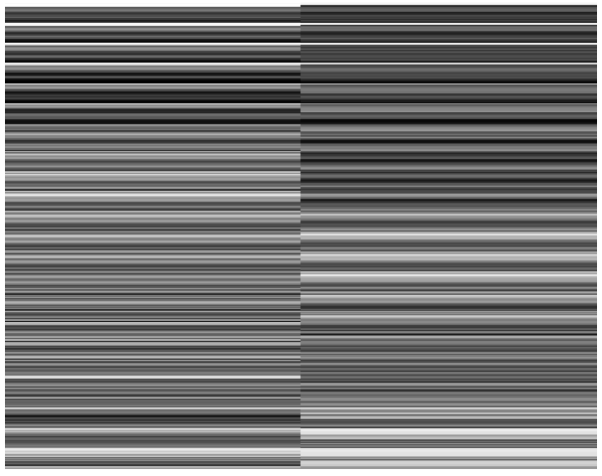
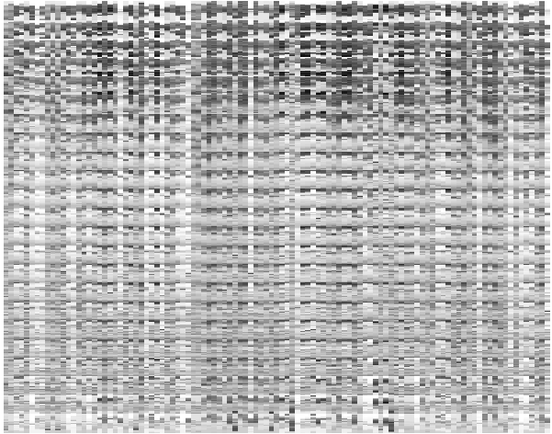

SVD Decomposition
2 by 1965
560 by 2
560 X 1965
-2.19
-3.19
-0.02
1.02
20 by 28
2 by 1
2 by 1
20 by 28

Slide 96
Nonnegative Matrix Factorization
对于非负矩阵A, 考虑下面的分解
Lee, D.D. and Seung H.S. Learning the parts of objects by non-negative matrix factorization. Nature 401, 788-791, 1999.

Slide 97
Why Non-negative?
In SVD, PCA, and VQ (Vector Quantification), entries of W and H with both have positive and negative signs
No obvious statistical interpretation for negative entries.

Slide 98
Interpretation of NMF
W_{nxk}: k basis images (“metagene” for gene expression data)
The basis images correspond to the “parts” of images.
H_{kxm}: Coefficients of “parts” for all images.

Slide 99
History
Nonnegative rank considered in the mathematics literature starting from 1983 (Gregory and Pullman) or perhaps earlier.
Given A_{mxn}, find W_{mxs},H_{nxs}, such that A=WH and s is minimal
Survey of applications and some interesting results about nonnegative rank due to Cohen and Rothblum (1993)

Slide 100
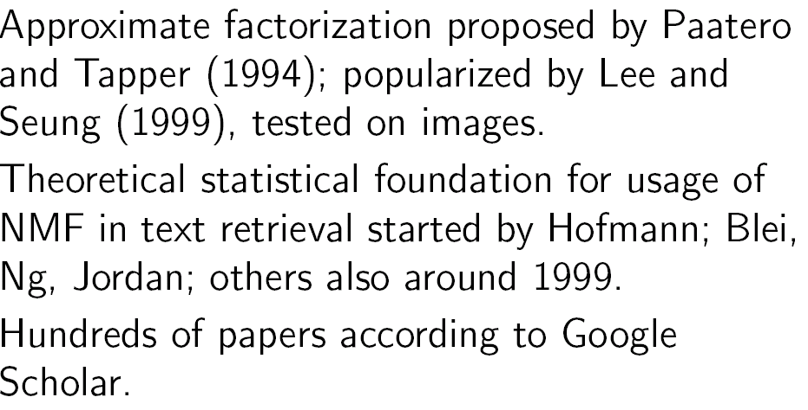
History

Slide 101
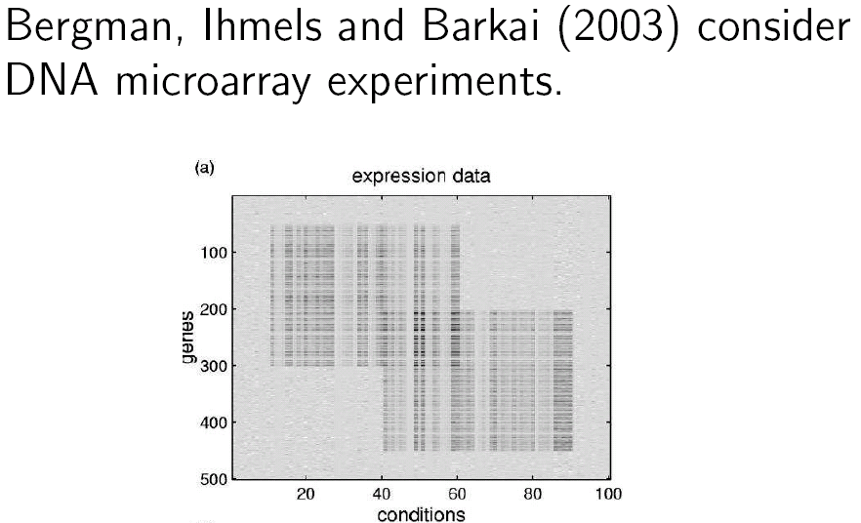
History

Slide 102
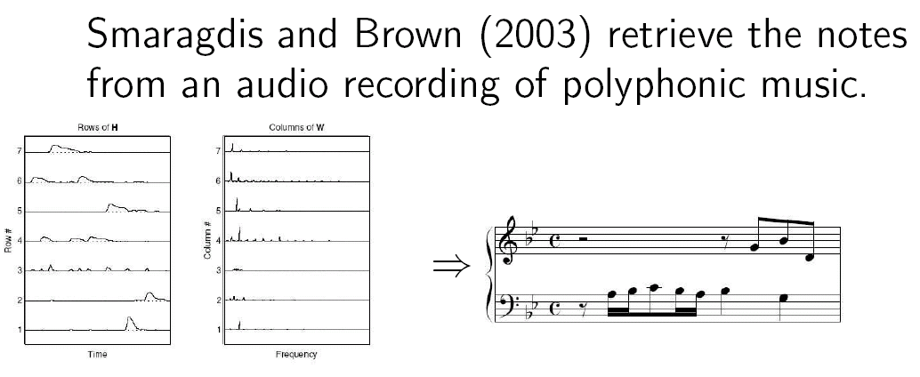
History

Slide 103
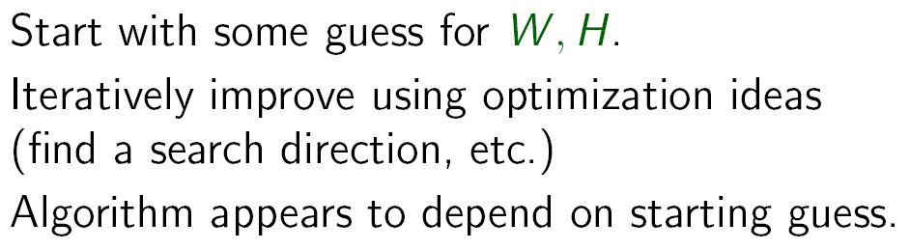
History (Algorithms)

Slide 104
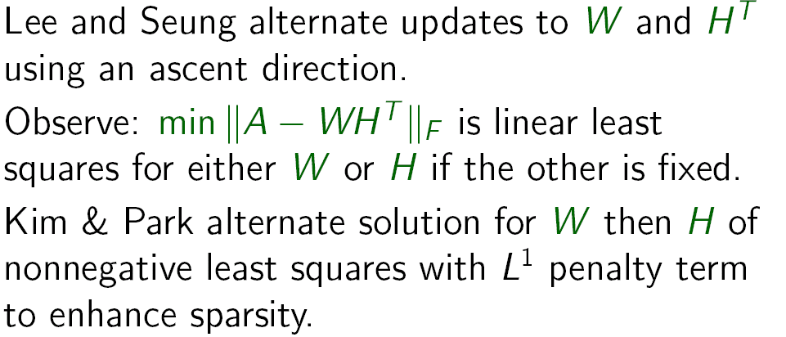
History (Algorithms)

Slide 105
Algorithm (I)
Frobenious norm (Euclidean distance)
Iterative update
Lee DD and Seung HS (2000) Algorithms for non-negative matrix factorization. In Proceedings of Neural Information Processing Systems, pp. 556–562.
Lee DD, Seung SH (2001) Algorithms for nonnegative matrix factorization. Adv
Neural Inform Process Syst 13: 556–562.

Slide 106
Algorithm (II)
Objective function (KL divergence)
Iterative update
Lee DD, Seung SH (1999) Learning the parts of objects by nonnegative matrix
factorization. Nature 401: 788–791.

Slide 107
Why is Sparsity Important?
Nature of some data
Text mining
Disease patterns
Better interpretation of results
Better predictions with sparse features

Slide 108
Sparse NMF (I)
Add a penalty function to the objective to encourage sparseness
L1 norm works well
Constraint on the scale of H is needed for identifiability.
Algorithm: Projected gradient descent method (SNMF/PGD)
Hoyer,P.O. (2004) Non-negative matrix factorization with sparseness constraints. J. Machine Learning Res., 5, 1457–1469.

Slide 109
Sparse NMF (II)
Add penalty to both W and H (SNMF/R)
Algorithm: alternating non-negativity constrained least square (ANLS)
Kim,H, Park.H. Sparse non-negative matrix factorizations via alternating non-negativity constrained least squares for microarray data analysis. Bioinformatics 23(12): 1495–1502, 2007.

Slide 110
ANLS
Solve the SNMF/R by following ANLS until convergence
Berry MW, Browne M, Langville AN, Pauca VP, Plemmons AJ. Algorithm and applications for approximate non-negative matrix factorization. Computational Statistics and data Analysis 52(1):155-173. 2007.

Slide 111
Sparse NMF (II)
The sparseness penalty can be added to W (SNMF/L)
Algorithm: alternating non-negativity constrained least square (ANLS)
Kim,H, Park.H. Sparse non-negative matrix factorizations via alternating non-negativity constrained least squares for microarray data analysis. Bioinformatics 23(12): 1495–1502, 2007.

Slide 112
Probabilistic Matrix Factorization (PMF)
For netflix problem with N users, M movies, R_{ij} is the rating of user i for movie j.
U user-specific latent feature
V movie-specific latent feature
Likelihood functions
where I_{ij} represent the rating status.
Salakhutdinov R and Mnih A. Probabilistic Matrix Factorization. NIPS 07, 2007.

Slide 113
PMF
Assume Gaussian prior
Log Posterior

Slide 114
PMF
Which is equivalent to minimize,
Where
Algorithm: Gradient descent in U and V.

Slide 115
Applications
Text mining (topic , clustering)
Computer vision (face recognition)
Bioinformatics
Clustering of gene expression data, subtype discovery
Dimension reduction, visualization
Devarajan, K. (2008). "Nonnegative Matrix Factorization: An Analytical and Interpretive Tool in Computational Biology". PLoS Computational Biology 4 (7).

Slide 116
Part IV Multi-dimensional Scaling (MDS)
部分Slide来自
www.cs.haifa.ac.il/~rita/uml_course/lectures/PCA_MDS.pdf‎

Slide 117
Dimension Reduction
Inputs: high dimensional
Outputs: low dimensional
Constraints: Nearby points remain nearby, distant points remain distant.

Slide 118
MDS
MDS attempts to preserve pairwise distances.
Attempts to construct a configuration of n points in Euclidian space by using the information about the distances between the n patterns (Not necessary n points in the high dimensional space) .

Slide 119
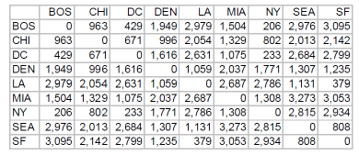
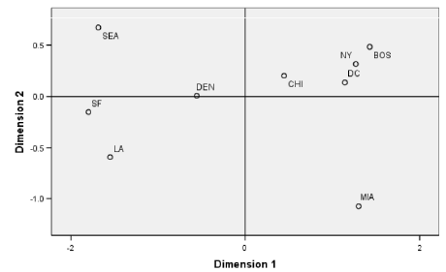
Example: Distances between US Cities

Slide 120
Classical MDS (I)
Given n points , the pairwise dissimilarities
Where l_{i} is the length of ith point.

Slide 121
Classical MDS (II)
Let
Then

Slide 122
Classical MDS (III)
Centralization
Let

Slide 123
Classical MDS (IV)
We have

Slide 124
Classical MDS (V)
Let
Let

Slide 125
Classical MDS (VI)
Then
Here

Slide 126
Classical MDS (VII)
Finally, we have
Then we can have a SVD of B (p<n)
where V is a matrix whose columns are the eigenvectors of B

Slide 127
Classical MDS (VIII)
With p-eignvectors, we can reconstruct B
With k-eignvectors, we can reduce the dimension to k-dimensional space

Slide 128
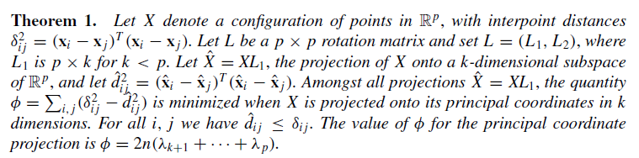
Classical MDS (IX)
Optimality property

Slide 129
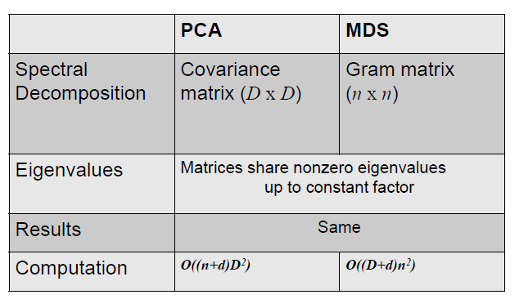
Relation to PCA

Slide 130
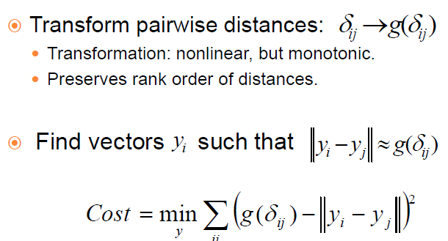
Non-metric MDS

Slide 131
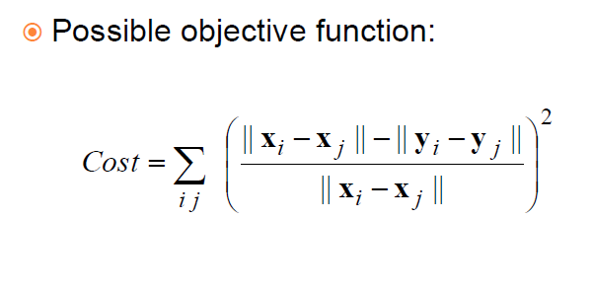
Non-metric MDS

Slide 132
Non-metric MDS
Strengths
Relaxes distance constraints.
Yields nonlinear embeddings.
Weaknesses
Highly nonlinear, iterative optimization with local minima.
Unclear how to choose distance
transformation.

Slide 133
MDS Implementation
MDS in R
isoMDS(MASS)
Kruskal's Non-metric Multidimensional Scaling
cmdscale(stats)
Classical (Metric) Multidimensional Scaling
sammon(MASS)
Sammon's Non-Linear Mapping
Various software and resources about MDS
http://www.granular.com/MDS/

Slide 134
Other Methods
Nonlinear dimension reduction
Kernel PCA
Locally linear embedding (LLE)
Isomap
A good tutorial：Ali Ghodsi. Dimensionality Reduction, A Short Tutorial. http://www.math.uwaterloo.ca/~aghodsib/courses/s09stat946/readings/tutorial_stat890.pdf
More materials can be found at his webpage http://www.math.uwaterloo.ca/~aghodsib/courses/s09stat946/

Slide 135
参考文献
薛毅，陈立萍. 统计建模与R软件. 清华大学出版社, 2007.
Christopher K.I. Williams. On a Connection between Kernel PCA and Metric Multidimensional Scaling. Machine Learning, 46, 11–19, 2002.

